Slide 1
Title: A Co-Simulation Virtual Reality Machinery Simulator for Advanced Precision Agriculture Applications
Author: Mauro cutini,Carlo Bisagila,Massimo Brambilla,Andrea Bragaglio,Federico pallottino,Alberto Assirelli,Elio Romano,Alessandro Montaghi,Elisabetta Leo,Marco PEzzola,claudio Maroni,Paolo Menesatti.
Presented by Ashiful hasan

Slide 2
Introduction
This research is conducted about precise agriculture farmer experience on digital agriculture,how important their training about their digital agriculture for precise agriculture,The Virtual reality how important and how helps in precise agriculture.

Slide 3
Related study
Immersive technology
Driving simulators
Virtual environment
Digital twin

Slide 4
Research
the present research aims to realize a tractor driving simulator intended to recreate the process innovation introduced by PA and quantify the relevant benefits
Energy consumption analysis
Optimization/update
Behavior analysis user operation guide
Technology integration

Slide 5
Requirements of simulation
Dynamics of the vehicle similar to an agricultural tractor
Monitoring tractor forces exchanged with the ground
Replication of engine behavior and related fuel consumption
Simulation of the main pillars of precision agriculture (PA)
Driving position layout
Operating conditions

Slide 6
Result
The Driving Position Layout
The Virtual Machines
The Operating Conditions
The Co-Simulation Software
Vehicle Dynamics

Slide 7
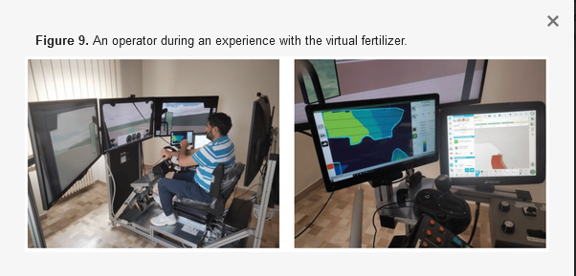
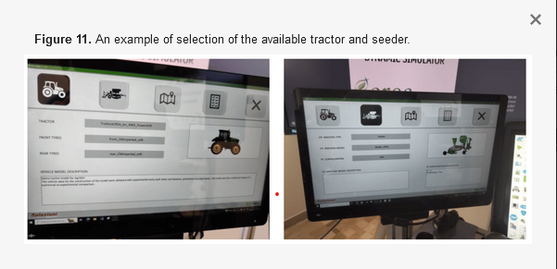
Figure of result data based on research

Slide 8
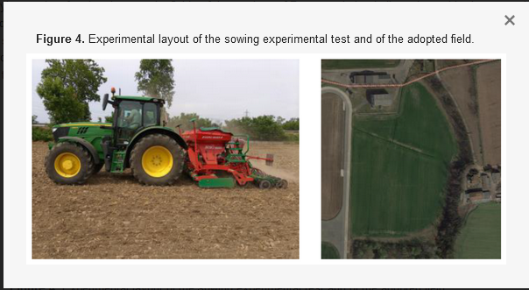
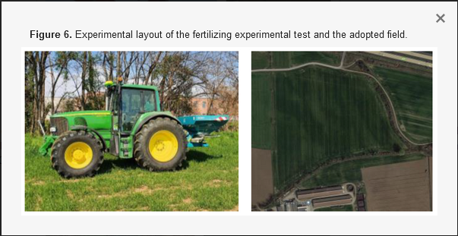
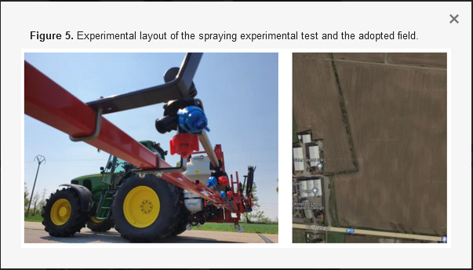
Tractor in experiments
.

Slide 9
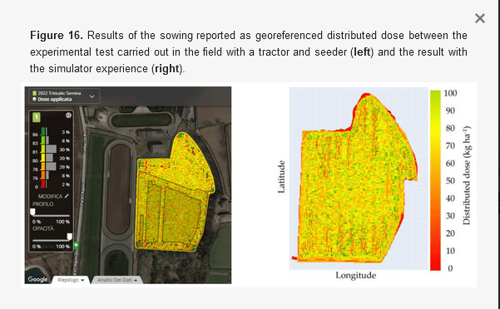
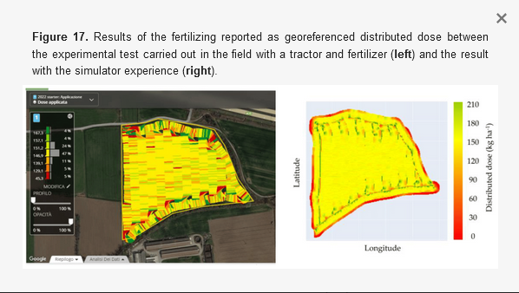
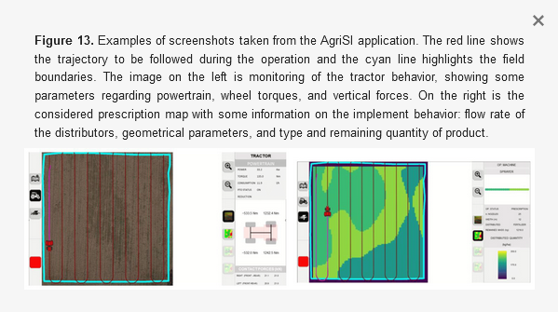
Conclusion
A human-in-the-loop approach was evaluated in the development of a simulator for precision agriculture. A static simulator (SimAgri) was purpose designed realized reproducing an agricultural tractor driving environment and used to emulate in-field operations. Vehicle and implement dynamics models have been implemented and correlated with experimental data. A software developed for PA simulation (AgriSI©) was used to quantify and rank operations’ results between several variants. The tool has been demonstrated to be effective in reproducing real tests and will be adopted for training tasks and to investigate the advantages of digital agriculture

